Slide 1
Solar Panel Analysis
Michael Cavellero, Deshan Yu, Evan Schwartzman

Slide 2
Did you know?!
The U.S. Energy Information Administration projects world energy consumption will increase 56% by 2040

Slide 3
Based on our current world usage of fossil fuels, we will run out of…
Oil in 2052*
Gas in 2060*
Coal in 2088*
* https://www.ecotricity.co.uk/our-green-energy/energy-independence/the-end-of-fossil-fuels

Slide 4
What’s the solution?
Renewable Energy Sources
Solar Panels

Slide 5
What’s the overall trend?

Slide 6
Questions from our Preliminary Analysis
Where are solar panels being installed?
Who is the target market?
Are there any correlations between installations and variables on the census data?
Notes:
From our preliminary analysis..we wanted to answer the following questions:
Michael – High Level Technical Overview on what we did to answer this question and where solar panels are being installed
Deshan-Who is installing them and analysis on relationship between census data and installations.
In order to answer these questions. We had to work with tools and multiple data sources-(transition to Mike).

Slide 7


Data Sources & Tools Used

Slide 8
Technical Workflow
Imported the census data with API Pulls.
Imported latitude, longitude & NREL Installation Open Source Data (CSV)
Merged dataframes on the key ”zipcode.”
Used Matplot, Seaborn, and Gmap packages to create data visualizations.

Slide 9
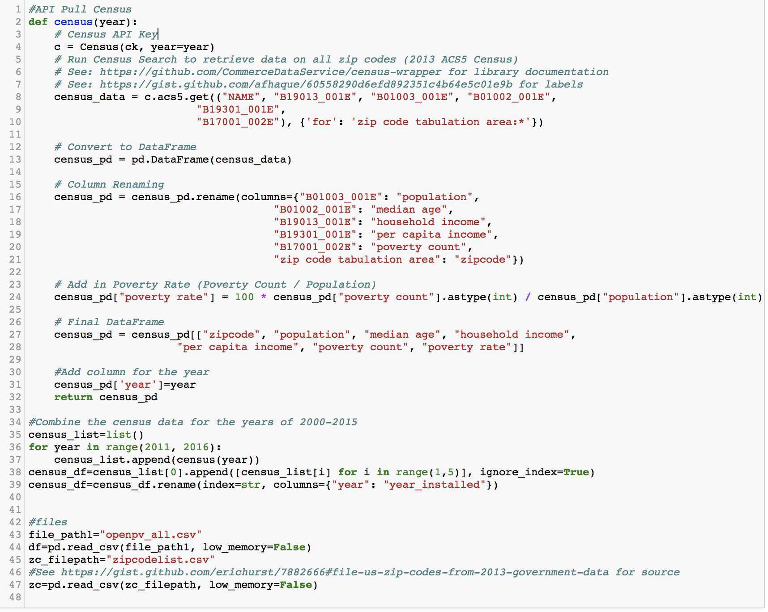
Data Import - API & CSV

Slide 10
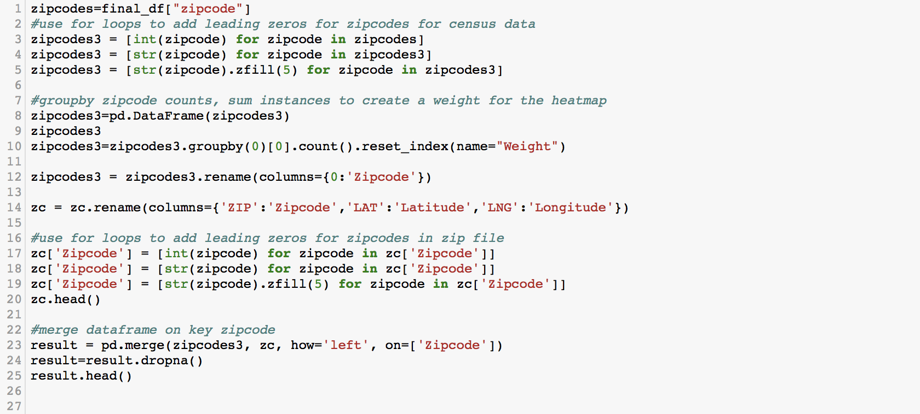
Merging the Data Imports

Slide 11
So…
What did we find?

Slide 12
Installations by State
Where are Solar Panels being Installed?

Slide 13
Heat Map - US
Where are Solar Panels being Installed?

Slide 14
Where are Solar Panels being Installed?
Heat Map - NJ
Notes:
Transition to Deshan – Now we know where..who is installing solar panels? Are there correlations or relationships between the census data and installations. Deshan will answer these questions.

Slide 15
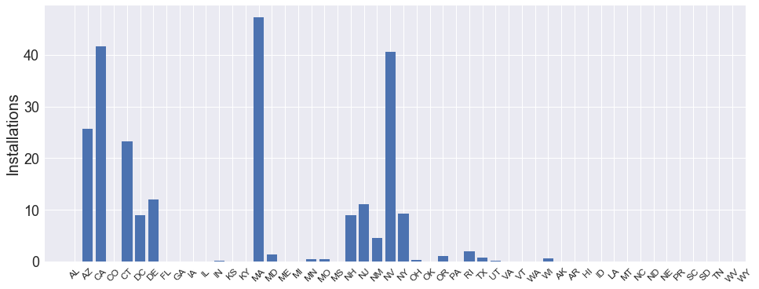
Installations by State
Massachusetts
California
Nevada
Arizona
Connecticut

Slide 16
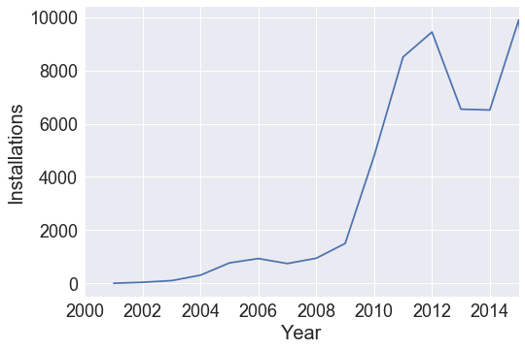
Installations Over the Years (NJ)

Slide 17
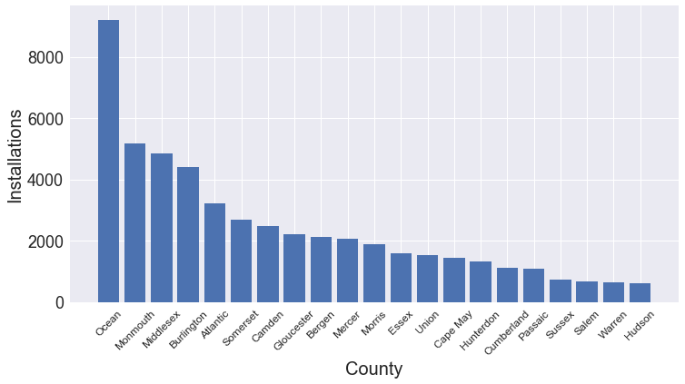
Installations by County (NJ)

Slide 18
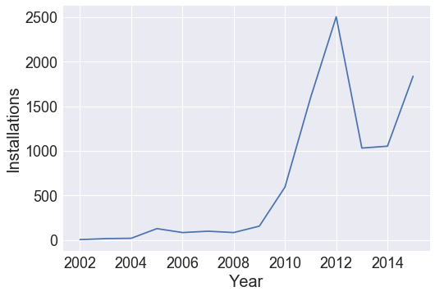
Installations Over the Years (Ocean County)

Slide 19
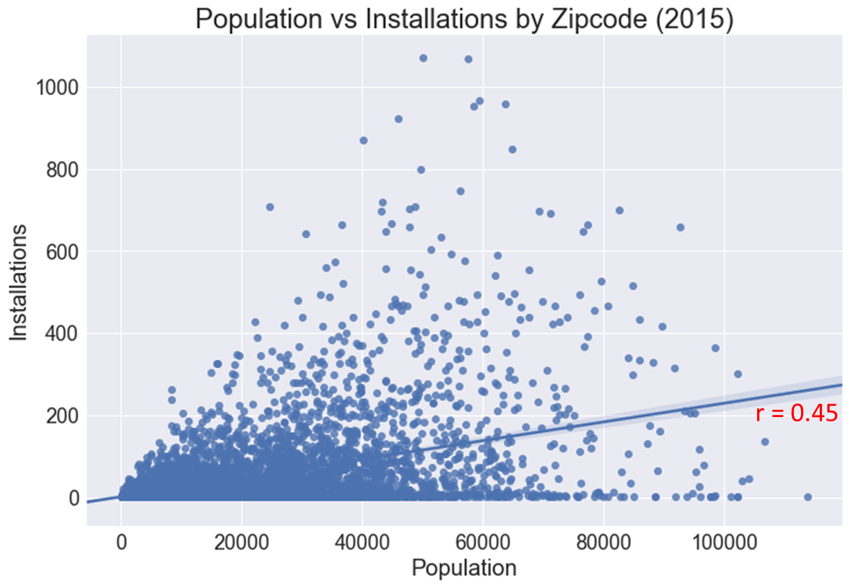

Slide 20
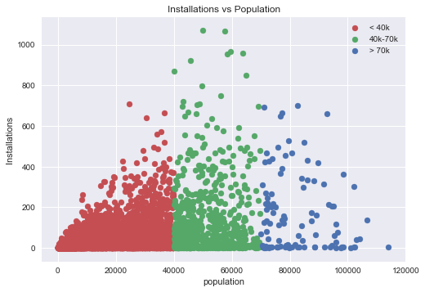
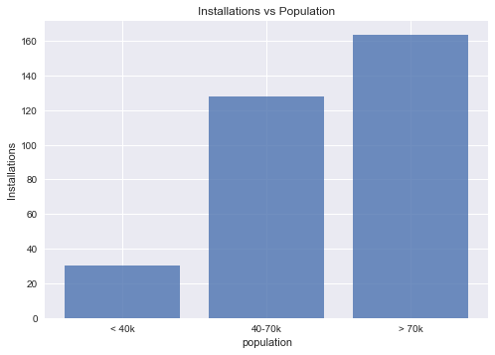
163
128
30
ANOVA | P = 0.00
T-Test | P = 0.00
T-Test | P = 0.0
T-Test |  | P = 0.07
Notes:
The mean installations are significantly more in zip codes with 40,000-70,000 population than those below 40,000 population. However, the installations in zip codes with greater than 70,000 population are not significantly more than those with 40,000-70,000 populations.

Slide 21
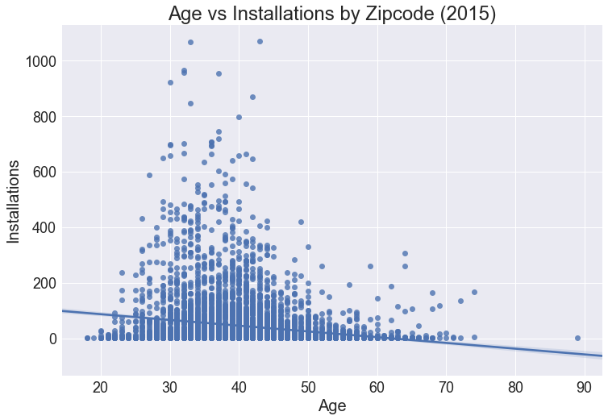
r = -0.17

Slide 22
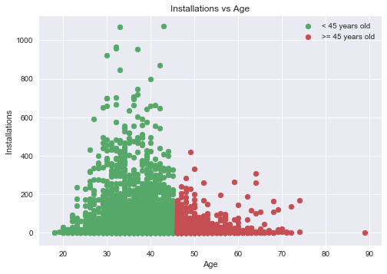
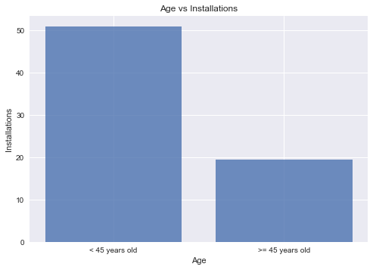
51
19
T-Test |  | P = 0.00
People under 45 years old have more installations than older people.

Slide 23
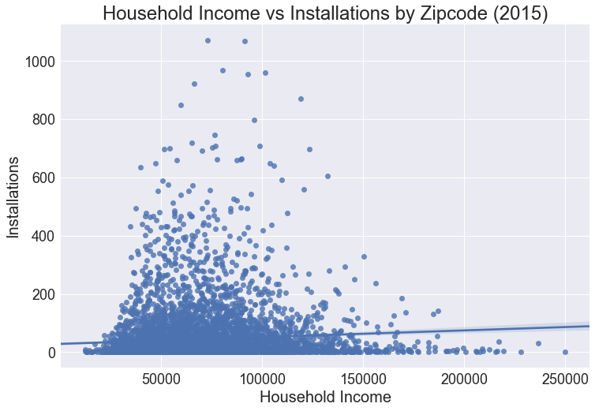
r = 0.07

Slide 24
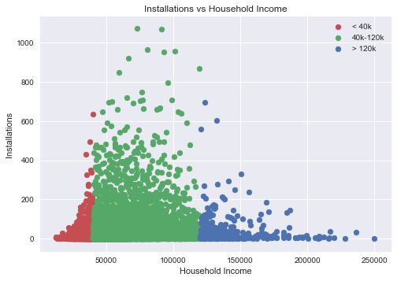
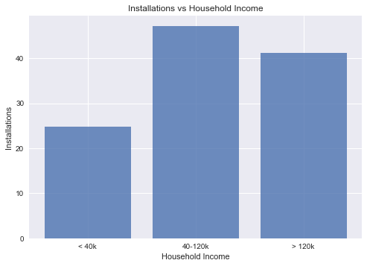
47
41
25
ANOVA | P = 0.00
T-Test | P = 0.00
T-Test | P = 0.0
T-Test |  | P = 0.21
Notes:
Household income above $40,000 means more installations than those below $40,000, but more income than $120,000 does not appear to have significantly more installations
Transition to Evan to show Jupyter Notebook and go over takeaways.

Slide 25
Let’s travel to a universe far, far away and…
Look at our code(Jupyter Notebook)…

Slide 26
Results
Takeaways:
Solar panels installations are on an upward trend.
The majority of installations take place in 8 key states.
The greater the population, the more likely installations will take place.
Those 45 years old and younger are more likely to install solar panels.
Those with income between $40,000 and $120,000 have the most installations.
Next Steps
Market Opportunity Analysis
Understand

Slide 27
Limitations of our Analysis
Incomplete data set (voluntary submissions).
Some states have less than 100 installs.

Slide 28
Questions?

